Slide 1
OVERVIEW
TARGET AUDIENCE: General public for awareness of the impact of waste/carbon creation by fashion industry. Consumers of fashion.
PURPOSE: To raise awareness about the scale and impact of fashion industry to encourage individual actions like sustainability awareness & second-hand shopping instead
DATA DESCRIPTION: Taken dataset from three sources:
OECD Global Plastic Outlook
Our World in data Plastic Pollution
Statista Sustainable fashion worldwide

Slide 2
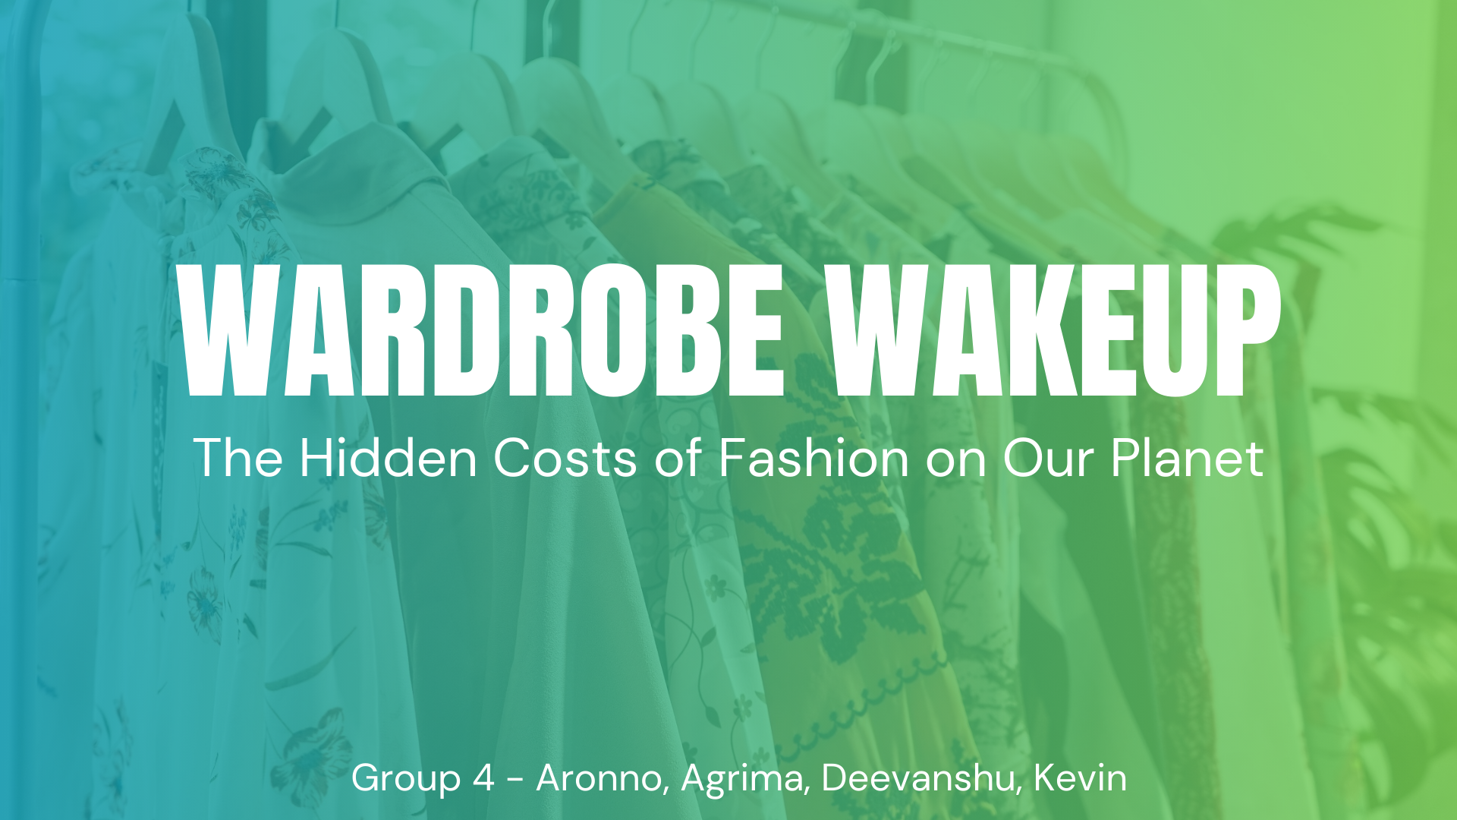

Notes:
Hi Everyone, want to take this time to in advance of our presentation to wish everyone a happy holidays season and thank you for your attention in the coming minutes. Today, we have taken the broader subject of plastic pollution and narrowed the scope to focus on the fashion/textile industry.
How many people think your clothing is currently sustainable?

Slide 3
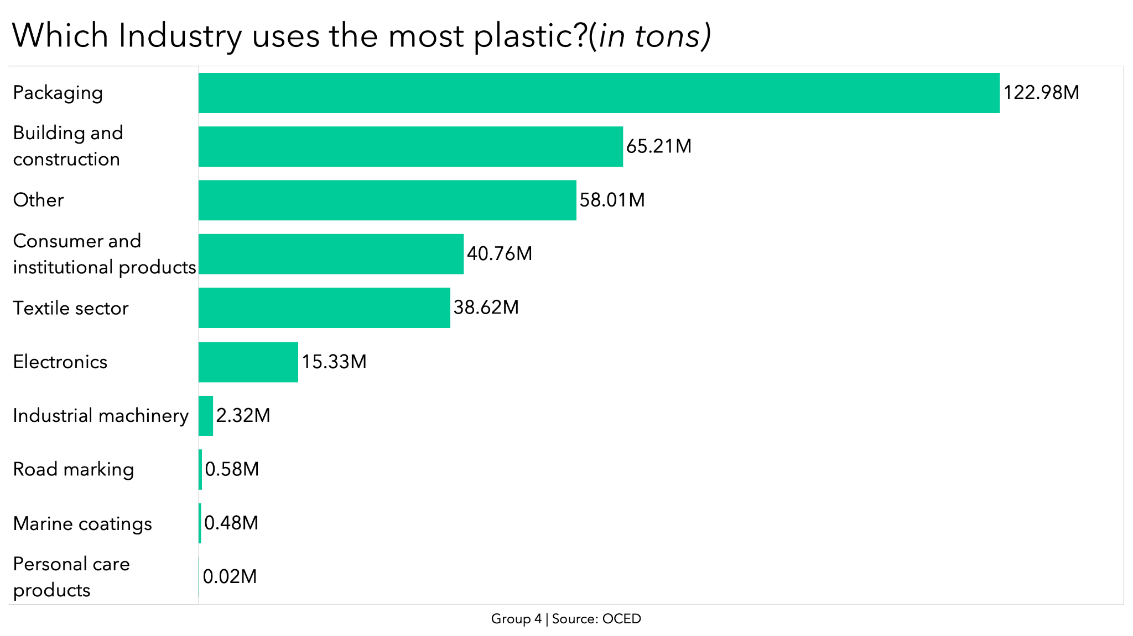
Notes:
As we see here the biggest areas driving plastic waste is from packaging, building/construction/ consumer products, and textiles. For our time with you today we have chosen to focus on the textile sector. Why, you may ask? Simply put, we are all currently wearing products that are a result of this sector. And as a result, we as consumers have some power to influence positive change.

Slide 4

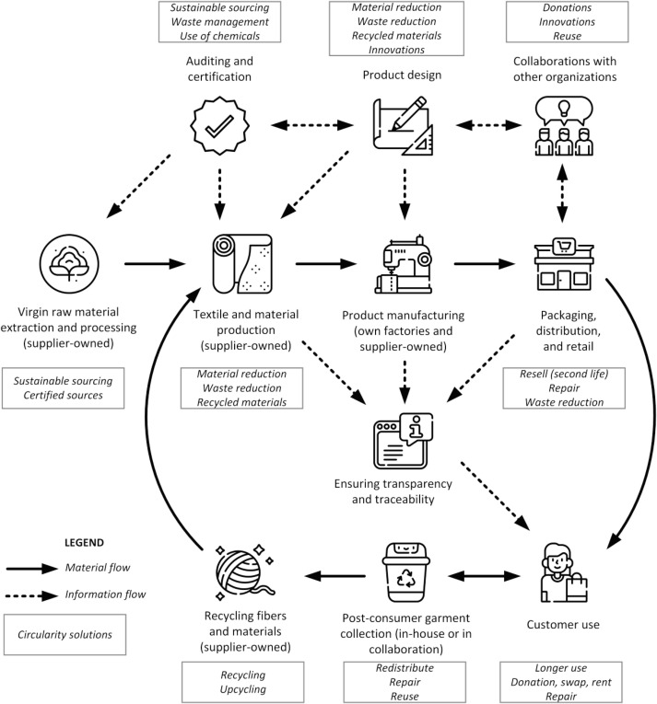
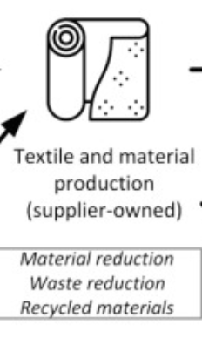
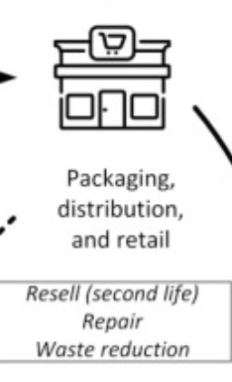
…Reduction/Prevention of textile microplastics release driven by implementation of sustainable design, production processes, and caretaking measures that control microplastic emissions during use, improve disposal, and end-of-life processing
Notes:
The main story here is that there is hope. As you can see production, packaging, and use contribute to plastic pollution in the largest ways. At the same time, there are established mitigation techniques such as implementing sustainable design, overhauling production processes, and other caretaking measures that can limit emissions, and end of life microplastic release

Slide 5

Estimates reckon the fashion industry is producing 100 billion articles of clothing a year – some 40% more than could ever be bought and actually worn. This figure is likely to be underestimated, and outdated. - Green Peace
Notes:
ARONNO
Here are some quotes from thought leaders that follow/govern the industry through various non-profit or state entities such as Green Peace and the European Environmental Agency, which is under the EU.
About 8% of European microplastics released to oceans are from synthetic textiles — globally, this figure is estimated at 16-35%. Between 200,000 and 500,000 tonnes of microplastics from textiles enter the global marine environment each year. (European Environmental Agency)

Slide 6
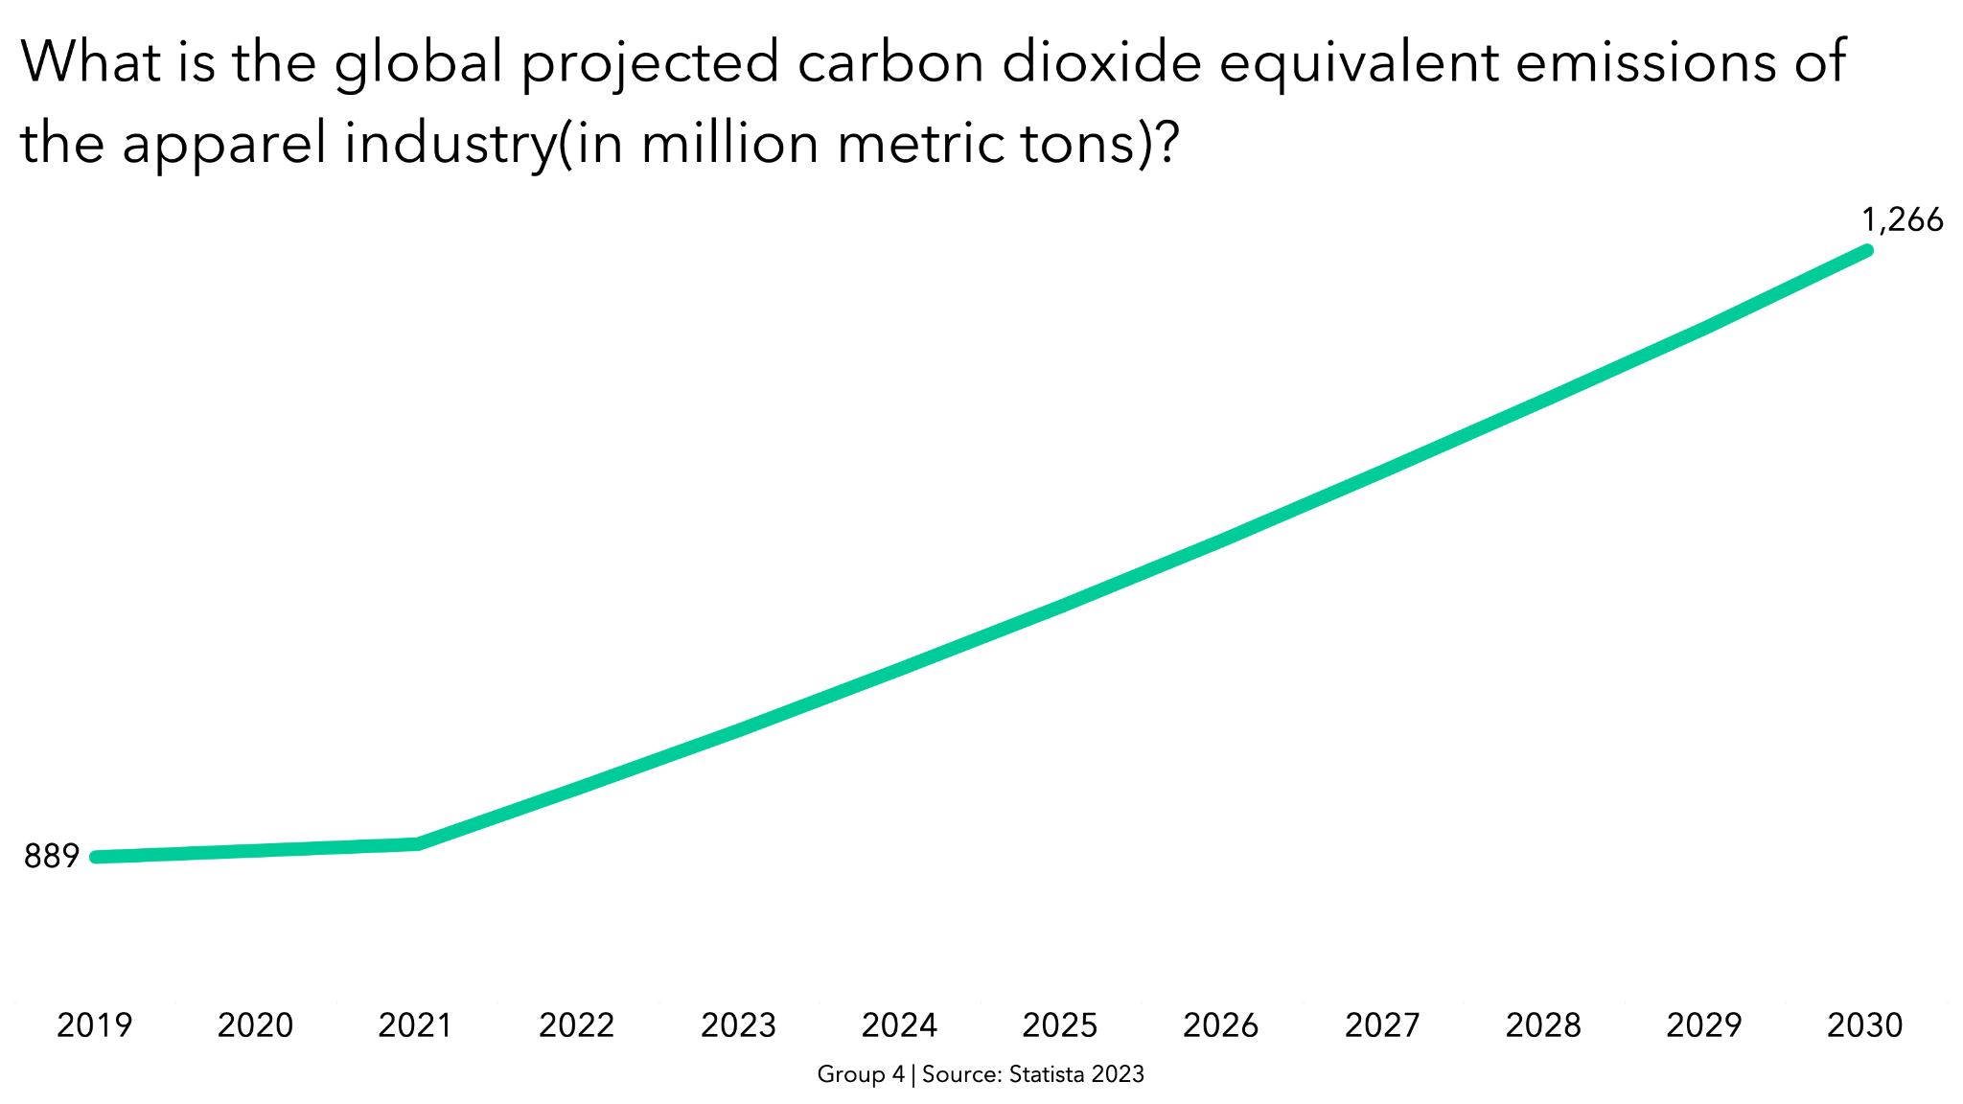
Notes:
So now that we’ve seen where we are at this current state in time. Let’s look at where the apparel industry is heading. We’ve already seen tremendous growth in the past 4 years, and unfortunately industry expectations do not see this trend slowing. In fact, in the next 7 years CO2 equivalent emissions are expected to total 1.3 billion metric tons.

Slide 7
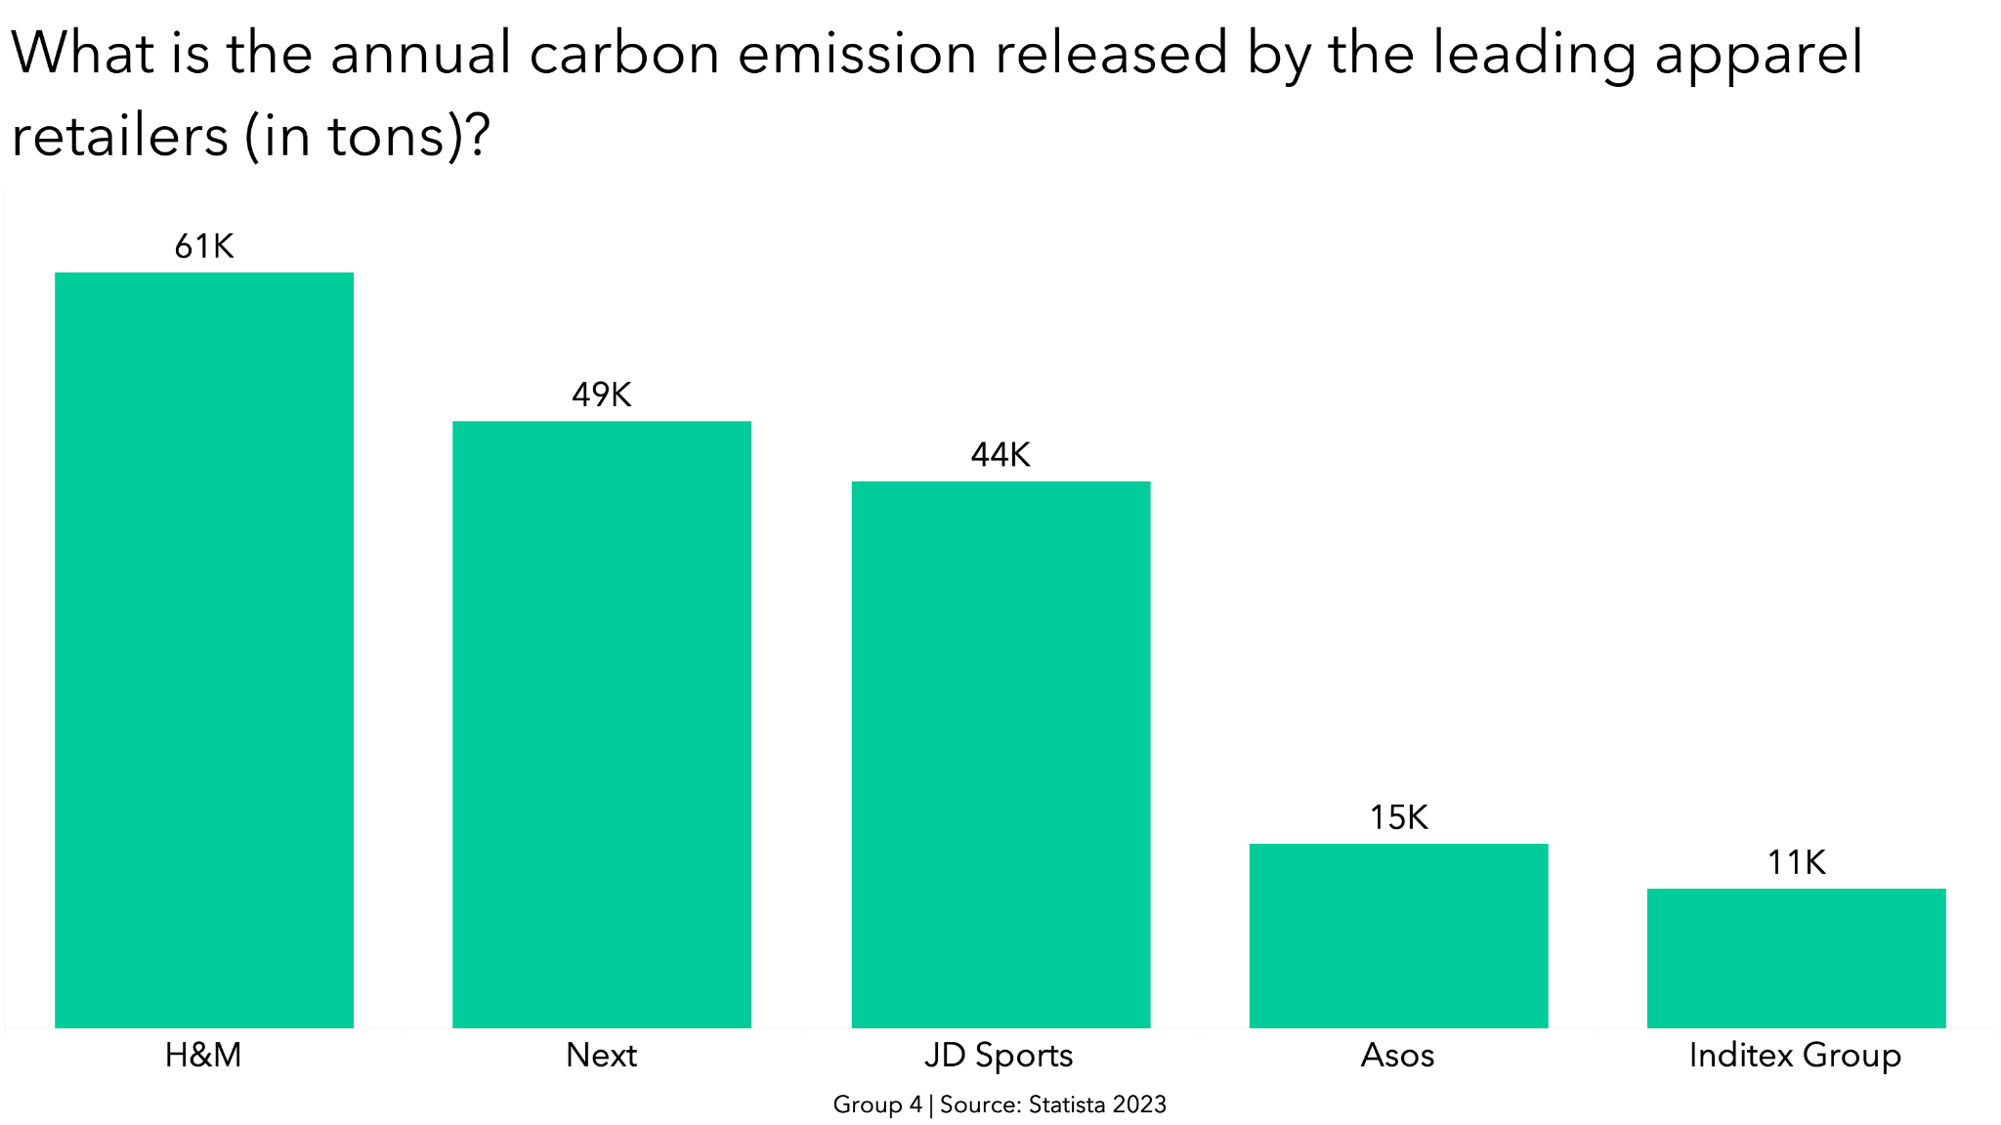
Notes:
AGRIMA
Here we can see the top apparel retailers contributing to the carbon emission. H&M being the highest contributor, producing around 61K tons carbon emission in a year. Following it the are the other retailers Next, JD Sports, Asos and Inditex Group. Inditex is the parent company of Zara.

Slide 8

Raise your hand if…..
How Important is Sustainability in your Fashion Consumption?
Extremely Important
Slightly Important
Neutral
Slightly Unimportant
Not important at all
Notes:
So now with the brief background that we’ve provided lets open it up to the group and see how we as a group stand on these issues. So after we ask this question we’d appreciate it if you’d raise your hand to indicate which degree refers to you.

Slide 9
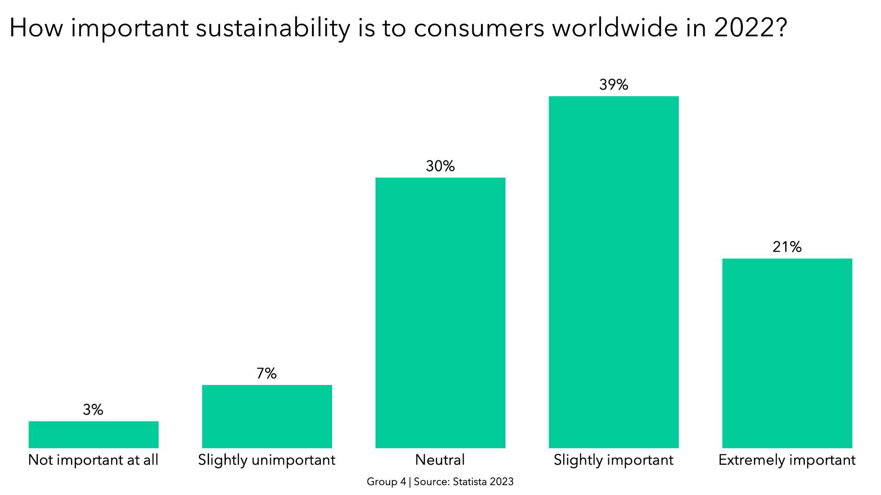
Notes:
DEEVANSHU So after looking at the questions we just asked you to indicate where we stand as a class this how we shape up against a worldwide consensus. As you can see, only 21% believe that this topic is extremely important to them.

Slide 10
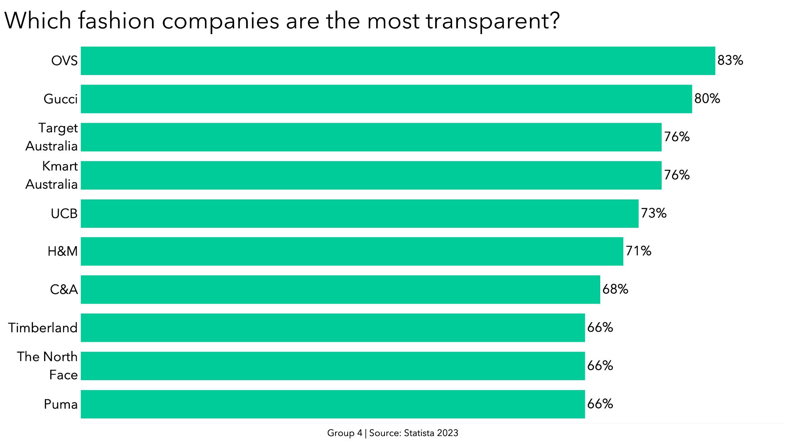
Notes:
DEEVANSHU To those of you who sustainability is important - ideally it should be all of you - above we see a list of the most transparent companies in regards to their plastic pollution. Subsequently, a take away here is to promote these brands, but as we saw earlier, just because a brand is transparent like H&M, it still doesn't negate the fact that they are a leader in polluting.

Slide 11
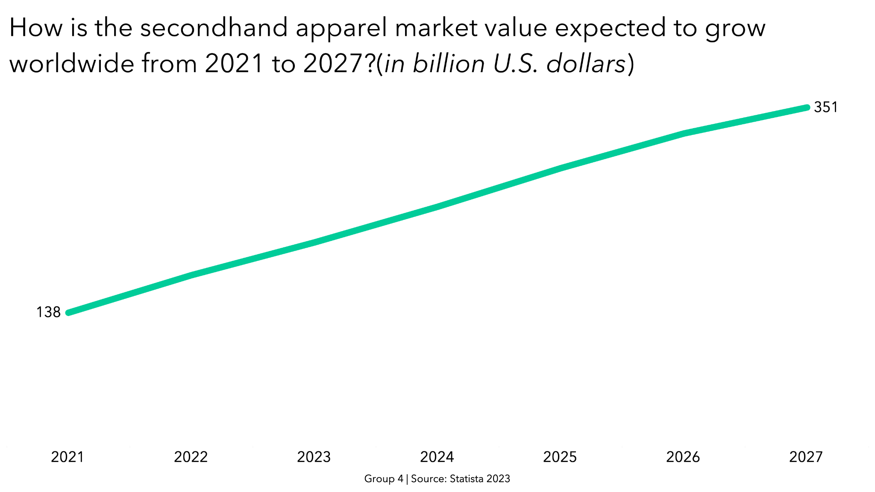
Notes:
DEEVANSHU
One great solution, is to participate in the purchasing within the secondary market. This cuts down waste and services existing product rather than generating statistical support for new production metrics.

Slide 12
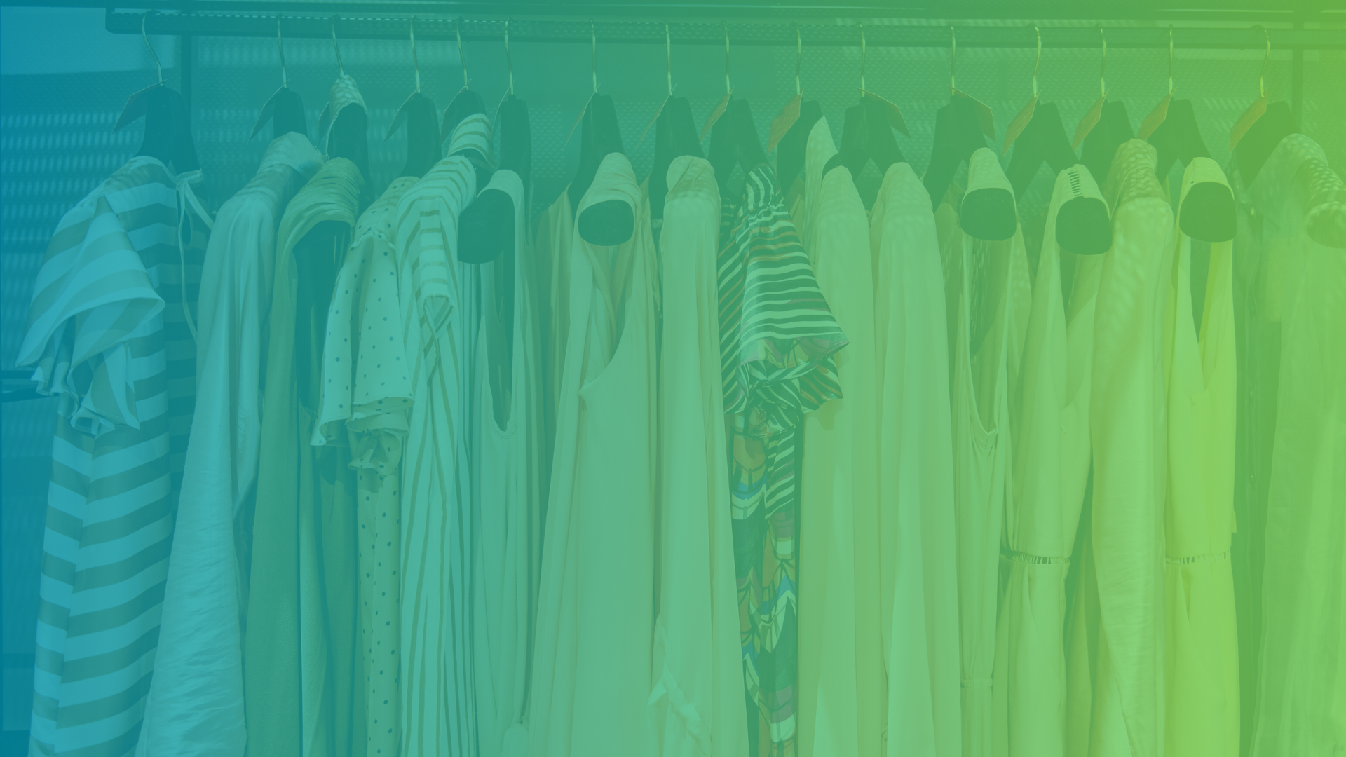
Call to Action
SHOP CONSCIOUSLY
DEMAND YOUR FAVORITE COMPANIES HAVE SUSTAINABLE PRACTICES
THRIFT & SECOND HAND
Notes:
DEEVANSHU

Slide 13

Team Members
Agrima Gupta (Team Lead, Graphics)
Deevanshu Srivastav (Designer, Presenter)
Aronno Shafi (Presentation, Presenter)
Kevin Klempner (Scripter, QA)

